Slide 1
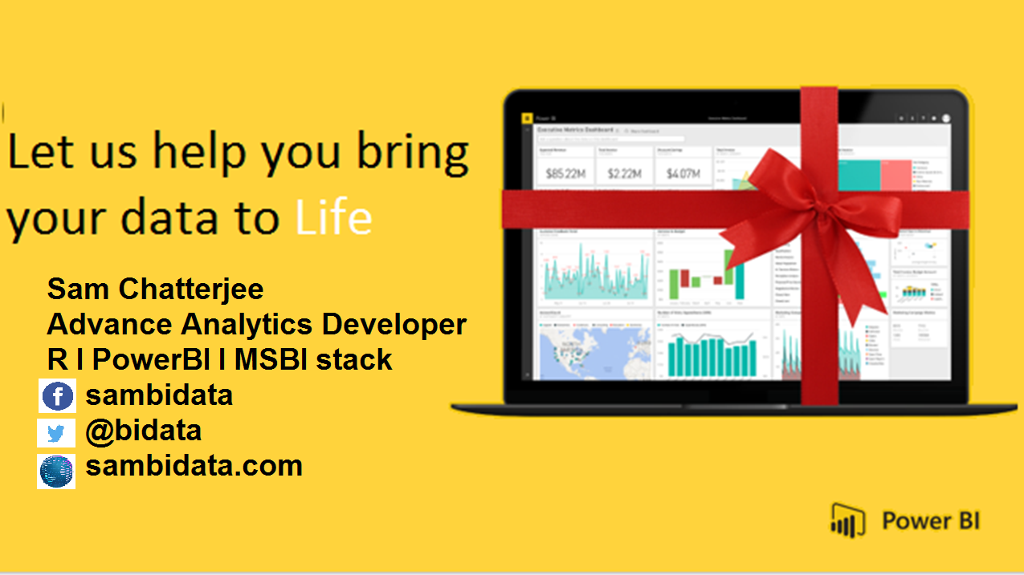

Slide 2



Slide 3


WHY
POWERBI

Slide 4
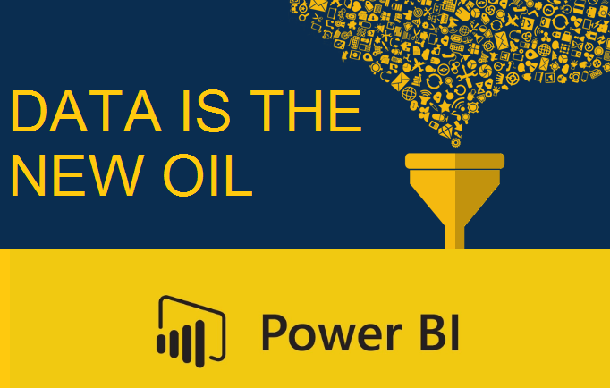

Slide 5
STAGES OF
BUSINESS INTELLIGENCE

Slide 6
Today, SSBI extends to everyone
3rd wave End user BI
Everyone
2nd wave Self-service BI
Analyst to end user
1st wave Technical BI
IT to end user

Slide 7





POWERBI PROGRESS
HOW THIS ALL STARTED
2014
2015
2016
2017
2018
Invention
Speculation
DEATH FACE
WINNER
LEADING
PowerBI service started
PowerBI under tremendous speculation by developers
Tableau and Qlik took over PowerBI
DEVELOPERS, MARKETERES WORKED HARD
POWERBI IS THE SOLUTION

Slide 8
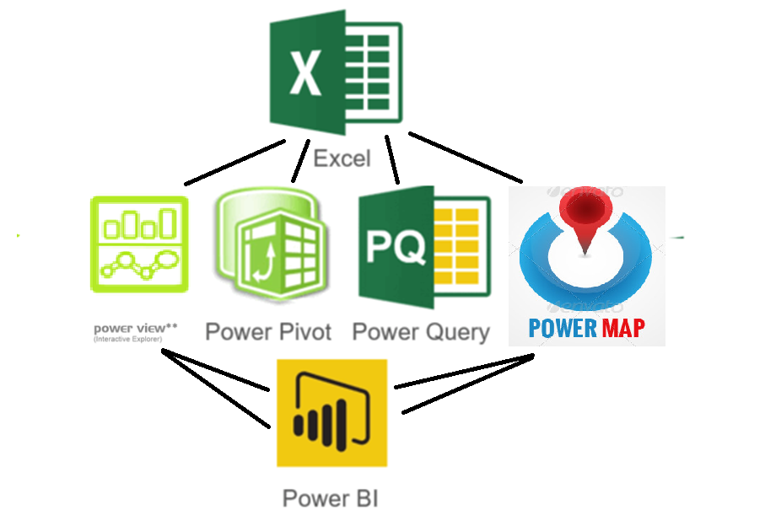
D
O
W
N
R
O
A
D

Slide 9
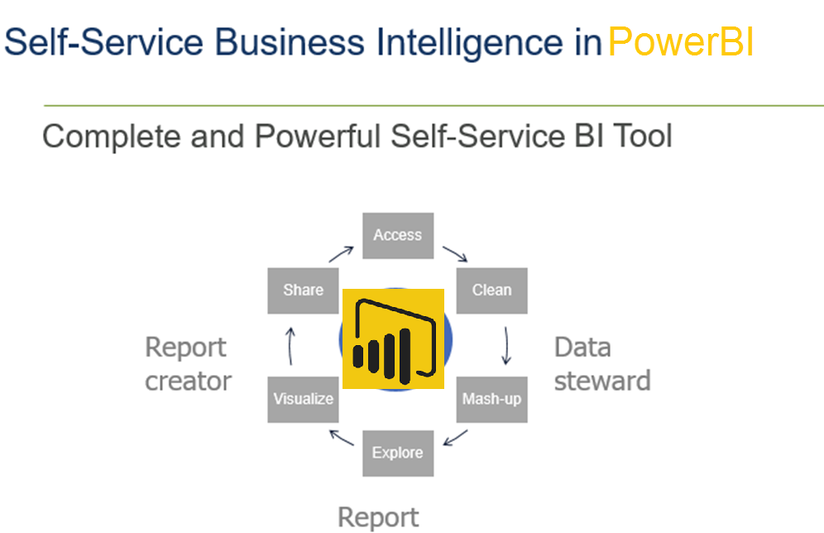

Slide 10




POWERBI INTEGRATIONS
MACHINE LEARNING
CORTANA INTEGRATIONS
MOBILITY
ADVANCE ANALYTICS

Slide 11
POWER BI-1
WHAT WILL YOU LEARN WITH THIS SESSIONS
60%
70%
50%
90%
STORY LINE UP
RESOURCES
GET DATA
DETECTING REALTION
We will work on the story
Proper resources on our story
Work with Data
Data Modelling

Slide 12
POWER BI-2
WHAT WILL YOU LEARN WITH THIS SESSIONS
60%
70%
50%
90%
APPLYING DAX
M
VISUALISATION
REPORTING
Calculated Column
Measures
Working With Power Query
Visualise
Power Bi Reporting And Sharing

Slide 13
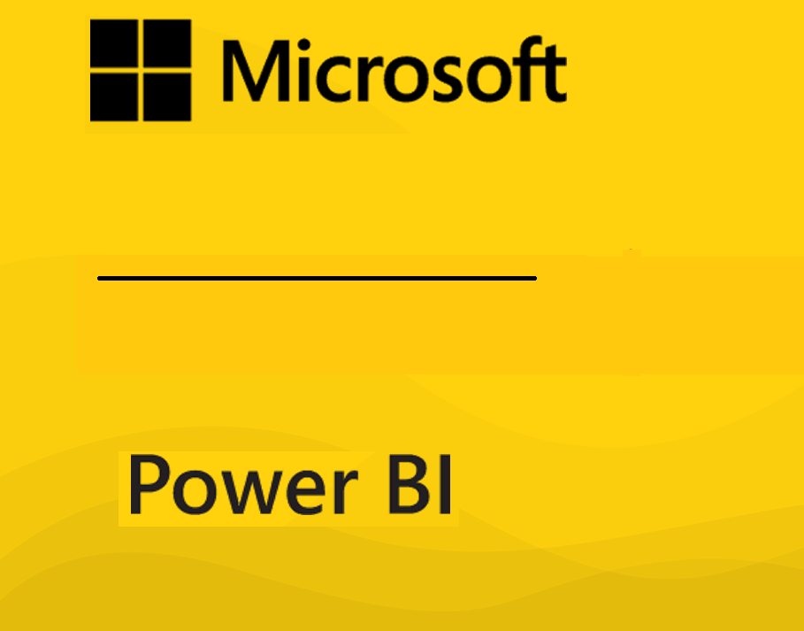




SSBI, MSBI, BI, DATA Professionals
Data Developers
Artificial Intelligence
Business Analysts

Slide 14
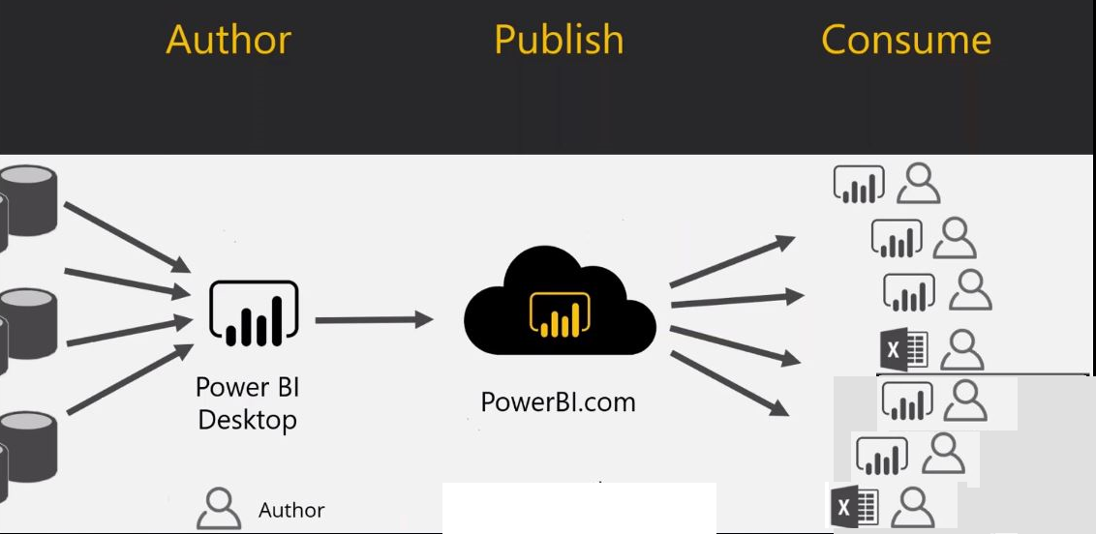
What’s PowerBI?

Slide 15
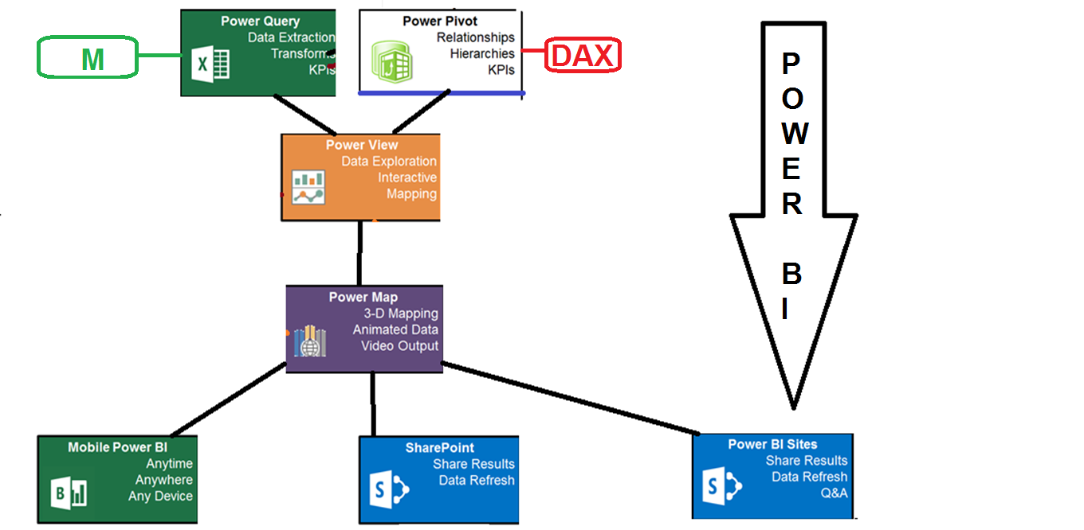

Slide 16
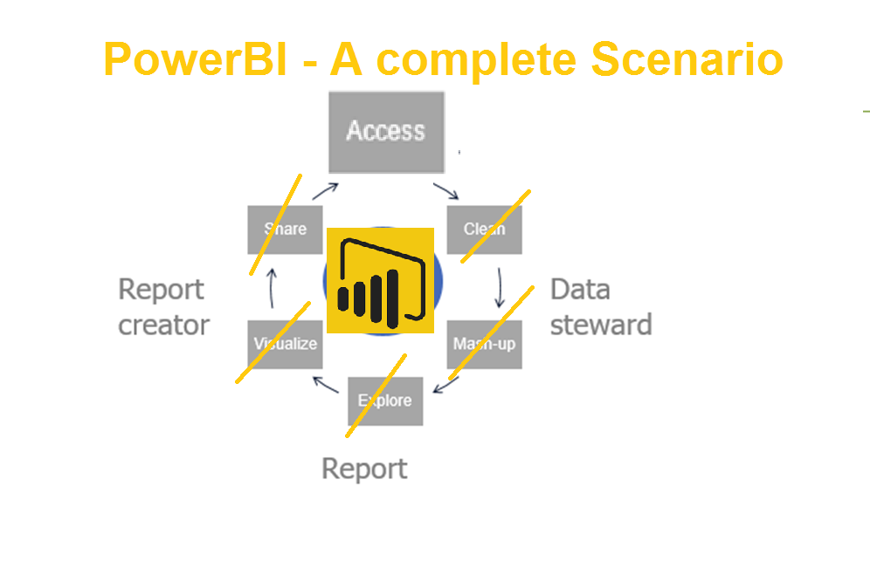
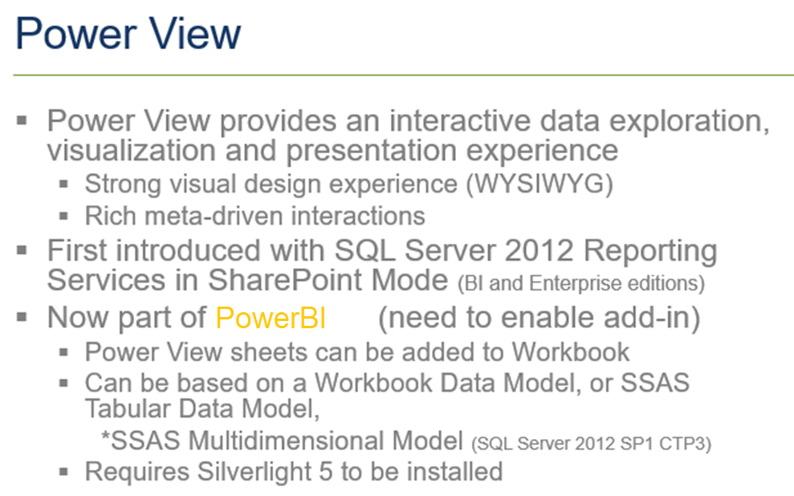

Slide 17
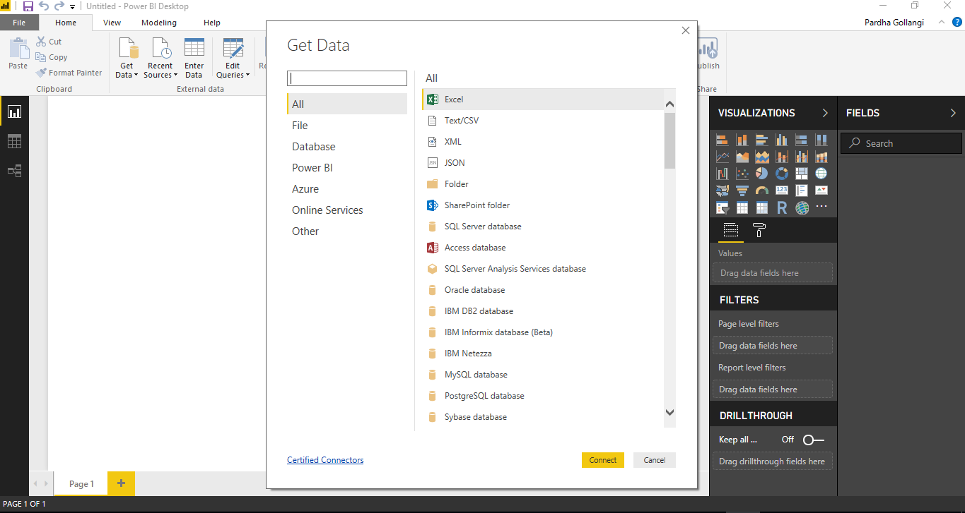

Slide 18
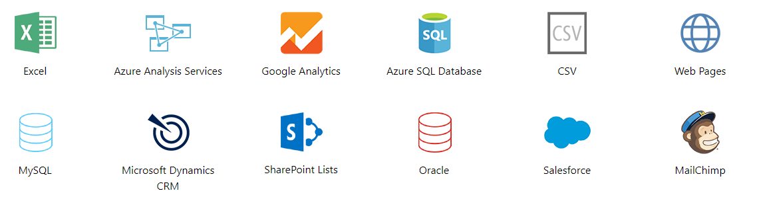
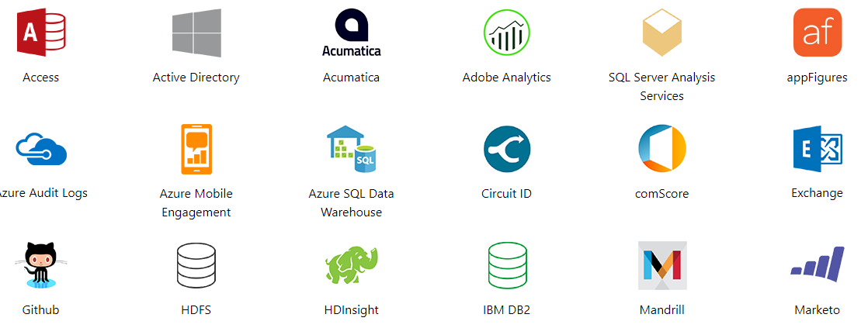

Slide 19
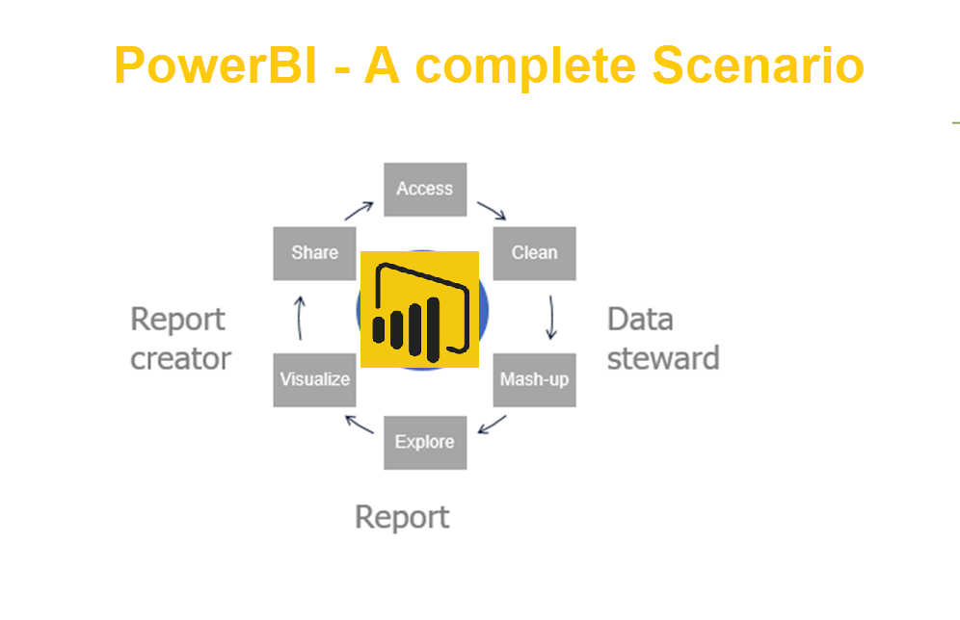

Slide 20
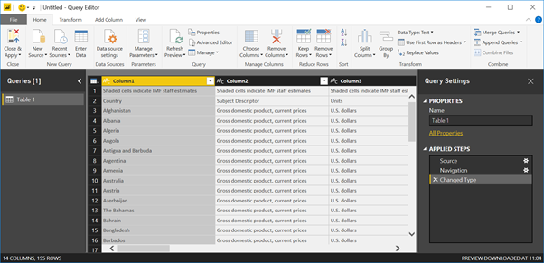

Slide 21

Power Query-II

Slide 22
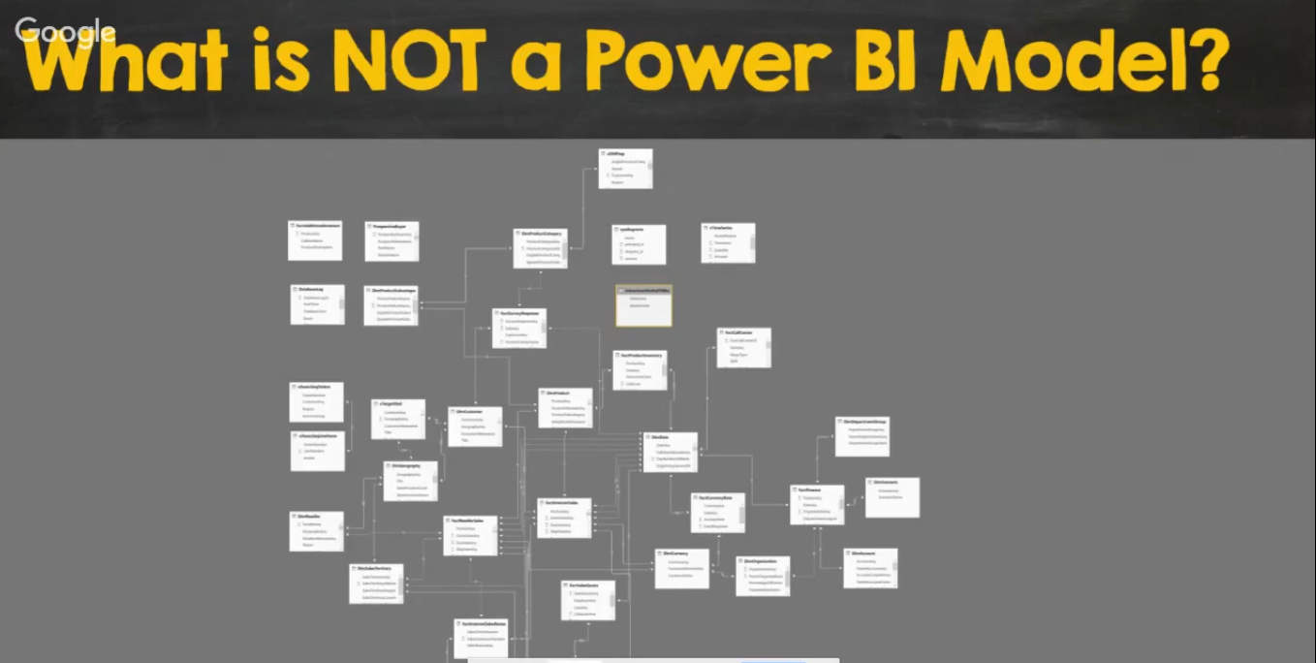

Slide 23

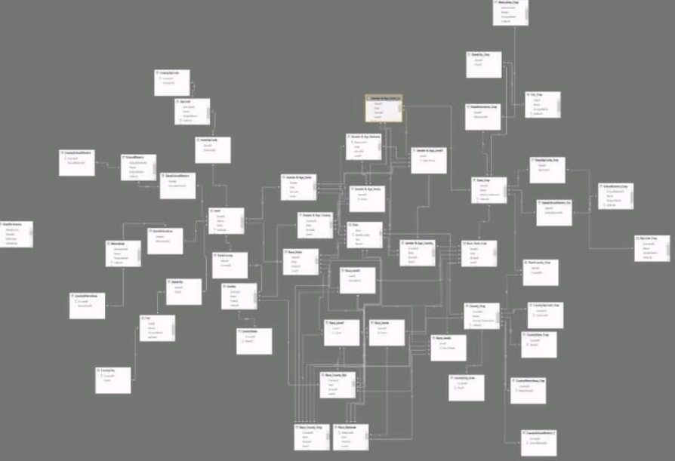

Slide 24
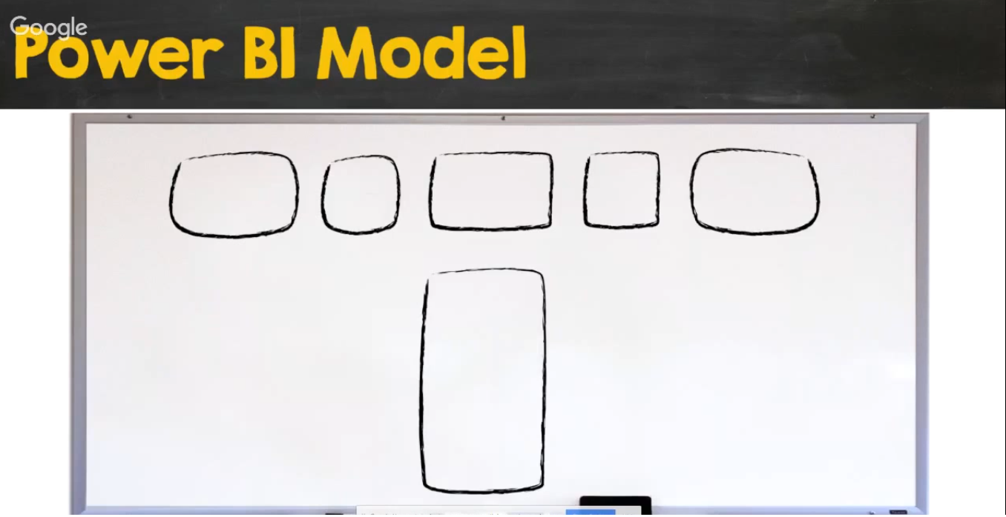

Slide 25
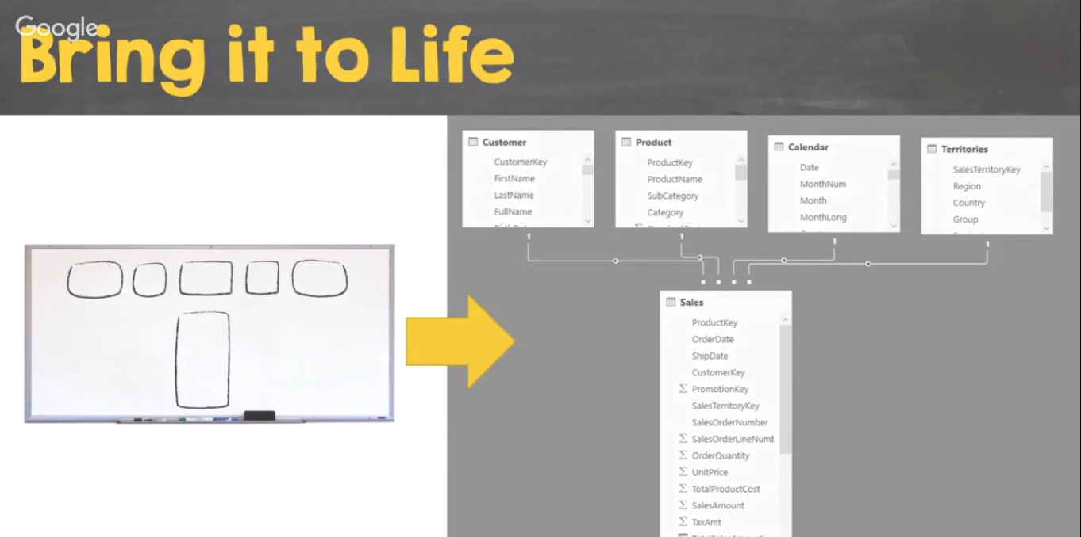

Slide 27
MASHUP BY ADDING
DAX MEASURES

Slide 28
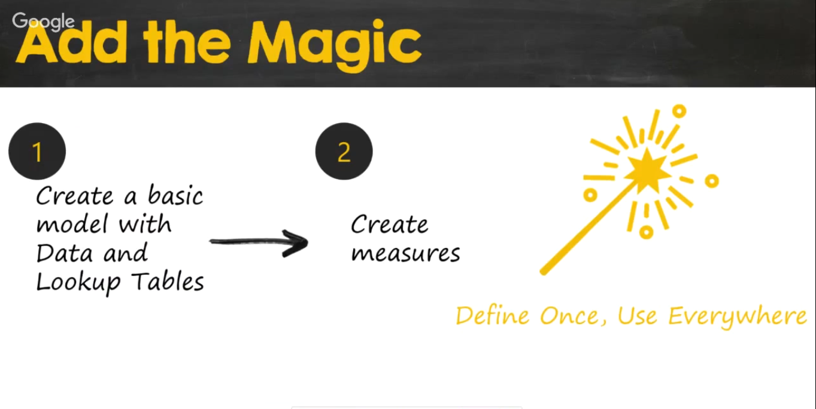

Slide 29
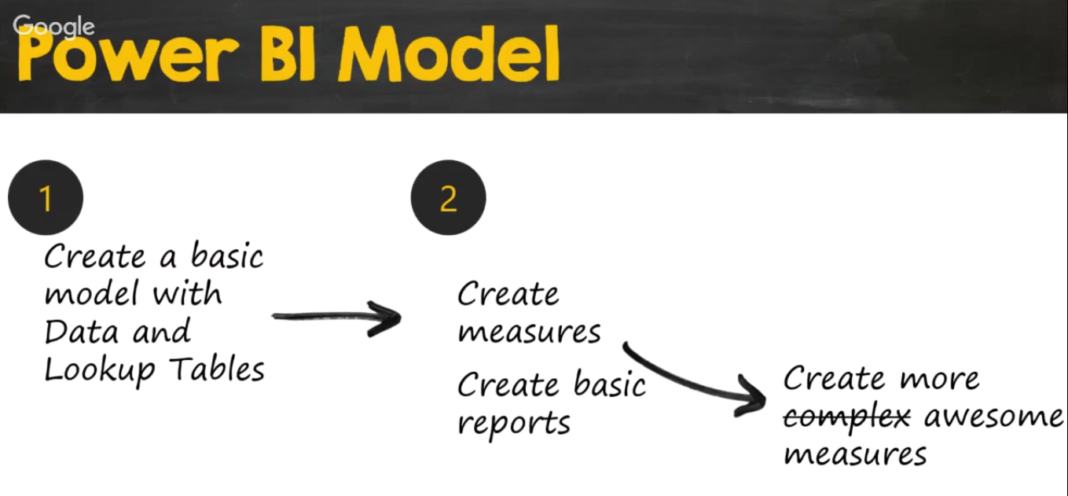

Slide 30
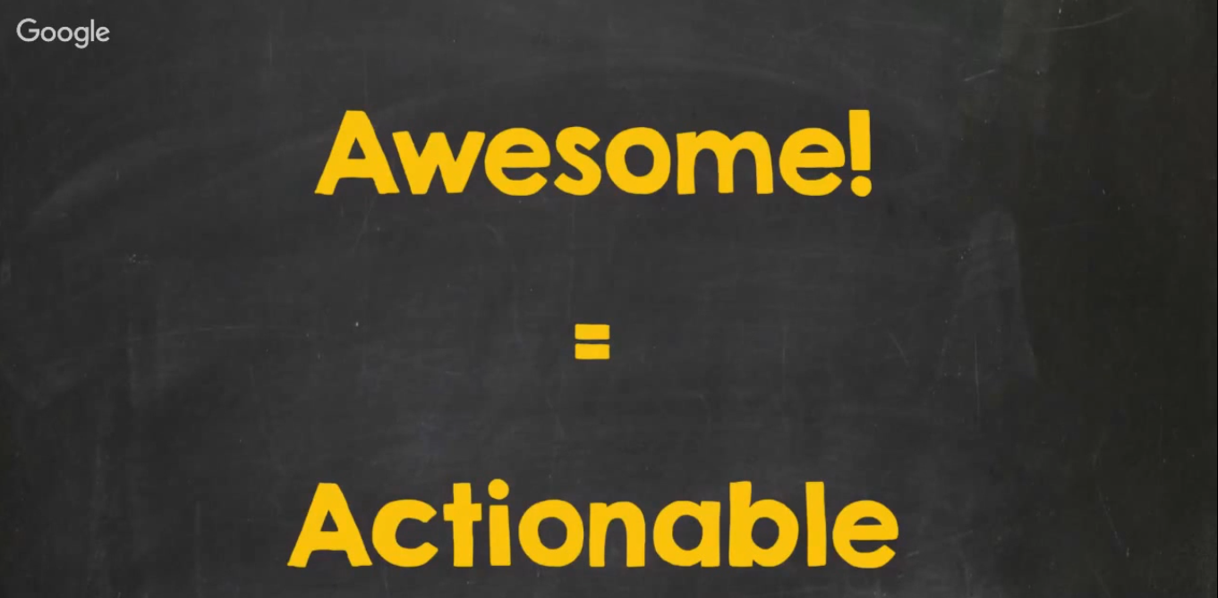

Slide 31
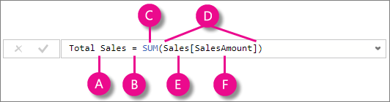
This formula includes the following syntax elements:
A. The measure name Total Sales.
B. The equals sign operator (=) indicates the beginning of the formula. When calculated, it will return a result.
C. The DAX function SUM adds up all of the numbers in the Sales[SalesAmount] column.
D. Parenthesis () surround an expression containing one or more arguments. All functions require at least one argument. An argument passes a value to a function.
E. The referenced table Sales.
F. The referenced column [SalesAmount] in the Sales table. With this argument, the SUM function knows on which column to aggregate a SUM.
When trying to understand a DAX formula, it is often helpful to break down each of the elements into a language you think and speak every day. For example, you can read this formula as:

Slide 32
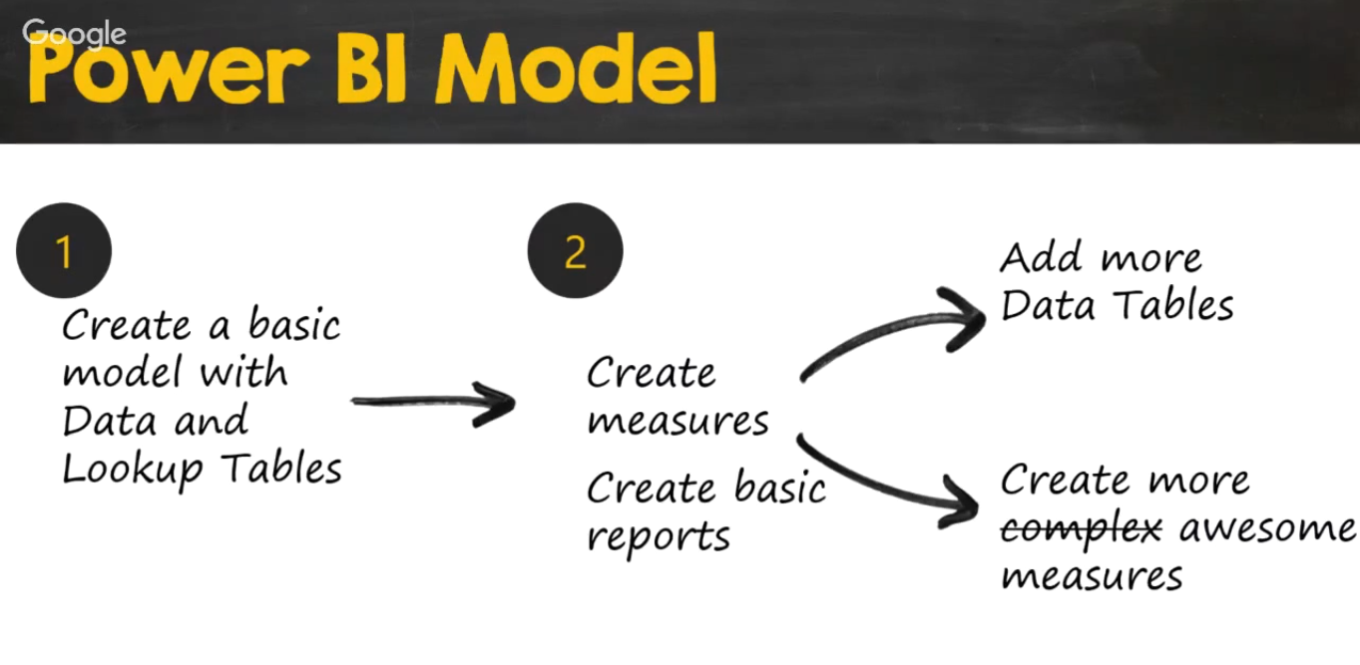


Slide 34
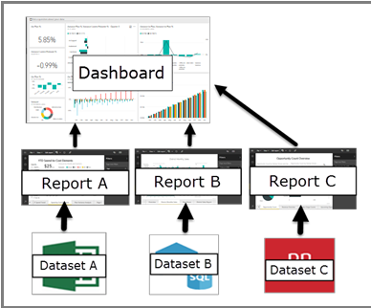
PowerBI Dashboard to visualise the data
A Power BI dashboard is a single page, often called a canvas, that uses visualizations to tell a story. Because it is limited to one page, a well-designed dashboard contains only the most-important elements of that story.

Slide 35
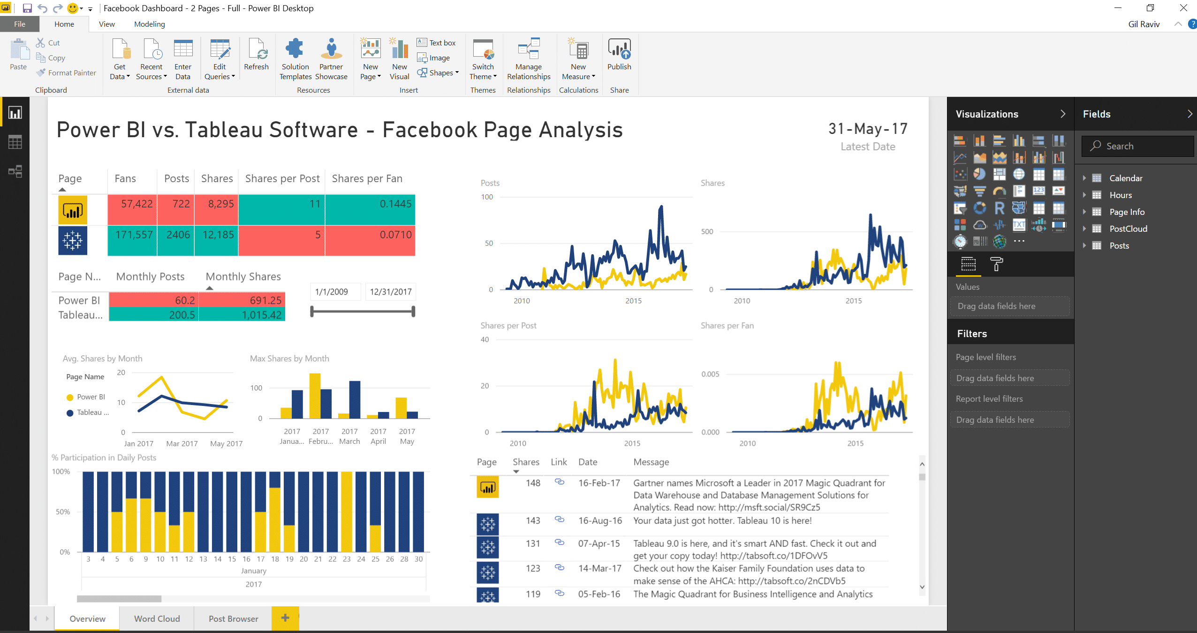

Slide 36
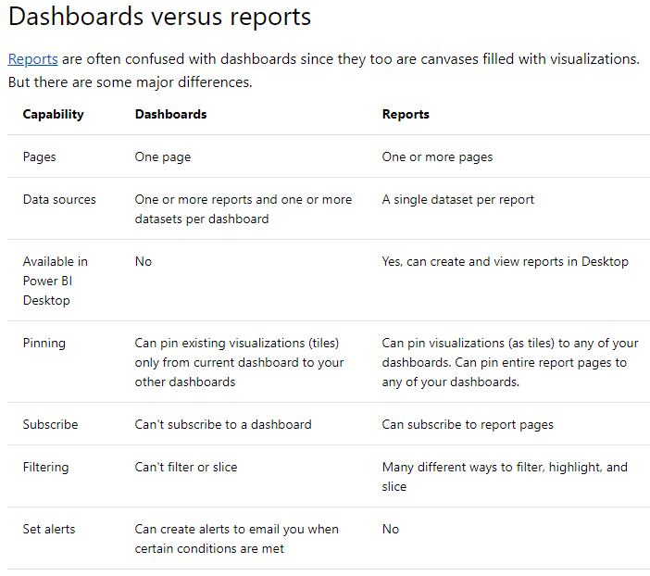

Slide 38
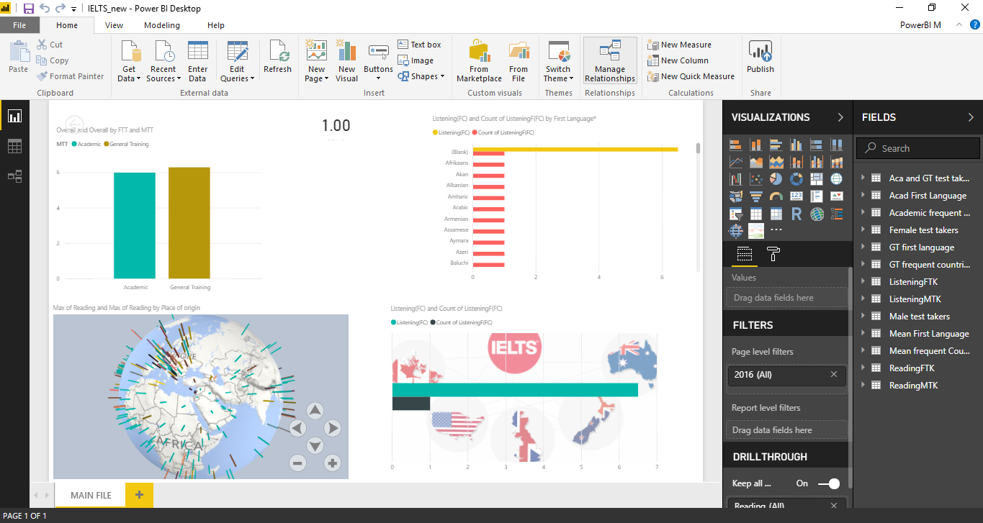
POWERBI DESKTOP

Slide 39
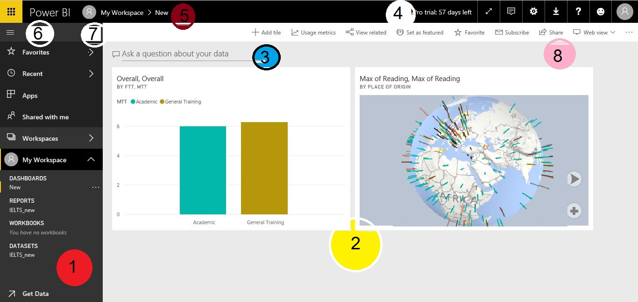
POWERBI SERVICE

Slide 40
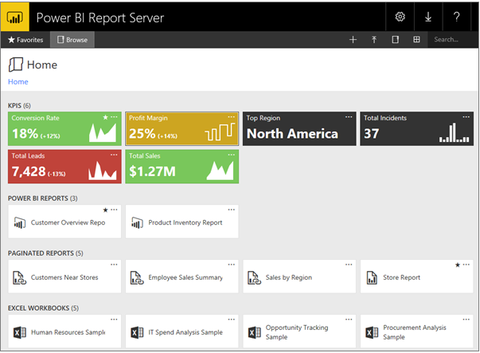
POWERBI REPORT SERVER
Power BI reports created with Power BI Desktop in the web portal and the Power BI mobile apps.
Paginated reports created in Report Builder: Modern-looking, fixed-layout documents optimized for printing.
KPIs created right in the web portal.

Slide 41
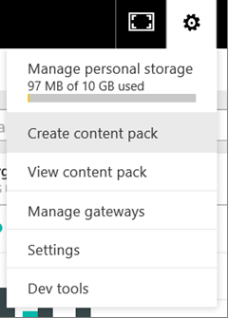
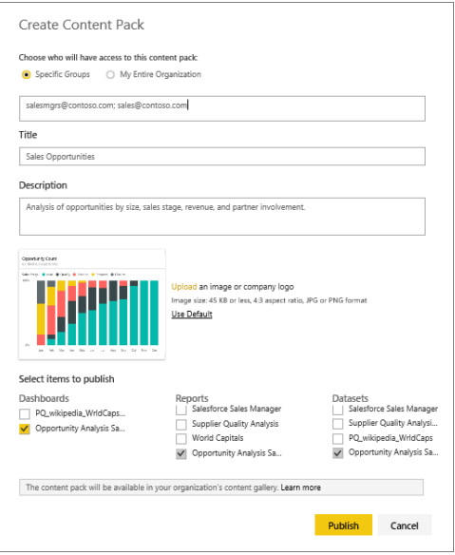
CREATE CONTENT PACK

Slide 42
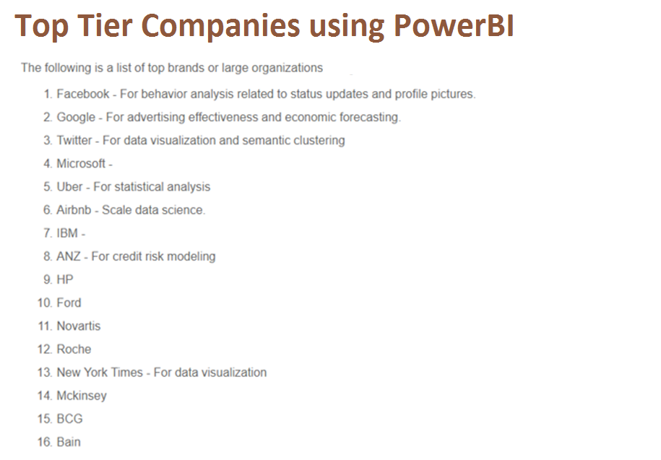
What will you achieve with PowerBI

Slide 43

KEYS
TO SUCCESS

Slide 44

#UNLEARNING IS THE WAY TO LEARNING
POWERBI
1. Copy Paste Data to Cobble it together.
2. Write forumlas and endless formulas.
3. Create Multiple versions of truth.
4. Spend hours trying to create effective reports.
5. Be the data-bottleneck

Slide 45
HOW CAN WE LEARN
POWERBI

Slide 46


Slide 47
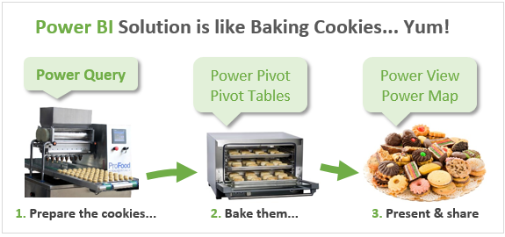

Slide 48




Resources
Get Power BI (Free) http://tinyurl.com/hj5hdg6
Power BI Jump Start http://bit.ly/1ktON16
Power BI Getting Started http://bit.ly/1FF88KA
Power BI Team Blog http://bit.ly/1vwbTLG
Power BI Channel 9 http://bit.ly/1a9Q0gv
Power BI https://powerbi.microsoft.com

Slide 49
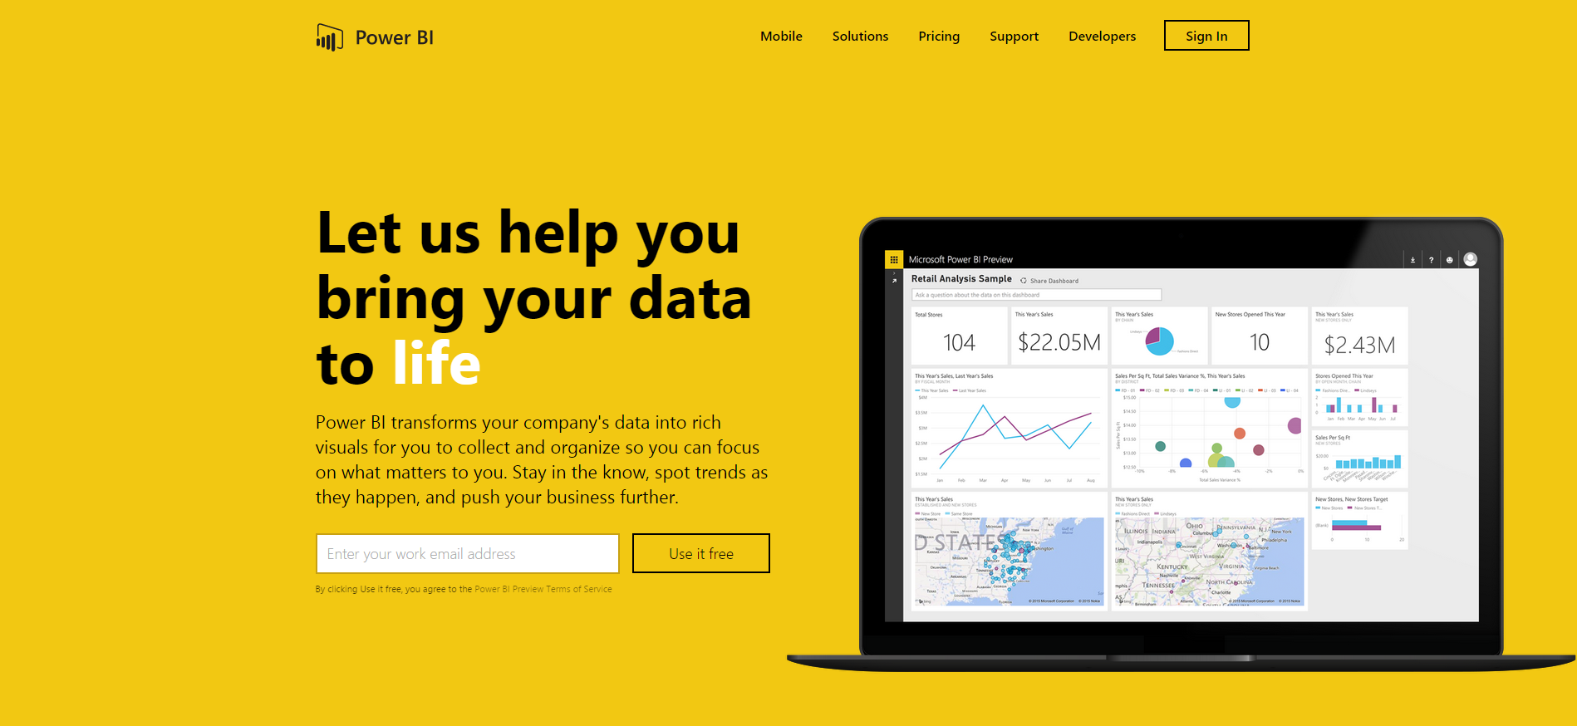
Thankyou for Coming to PowerBI
Sign up for a free Preview account
Take the Power BI Tour

